Slide 1

­­­­­The Evolution of Stress-Induced Mutagenesis: Causes and Consequences Yoav Ram PhD Seminar Tel-Aviv University 6 April 2016
http://memegenerator.net/Jayz-99-Problems

Slide 2
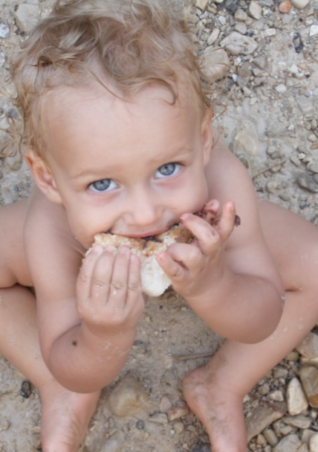
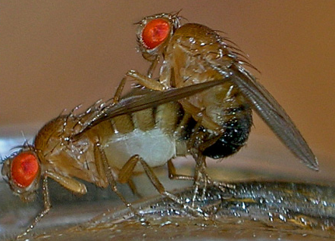
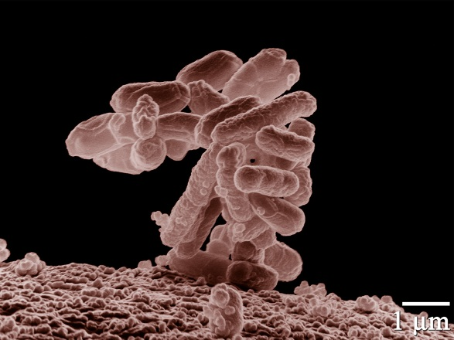
Variability in mutation rates
Between species
Rates are in average number of measurable mutations per genome per generation
Flies: 0.455
Keightley et al. Gen Res 2009
Humans: 41
Lynch, PNAS 2010
Bacteria: 0.0004
Wielgoss et al. G3 2011

Slide 3
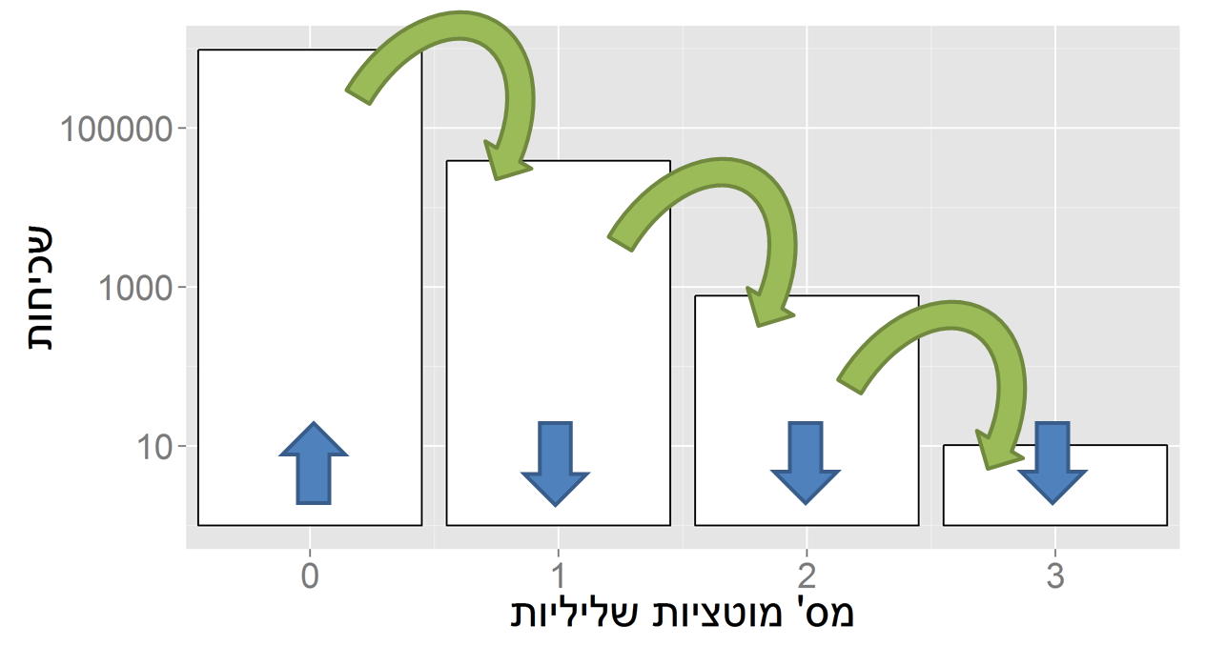
Evolution in a static environment
Directional selection without change
A balance between mutation and natural selection
Frequency
# Deleterious mutations

Slide 4
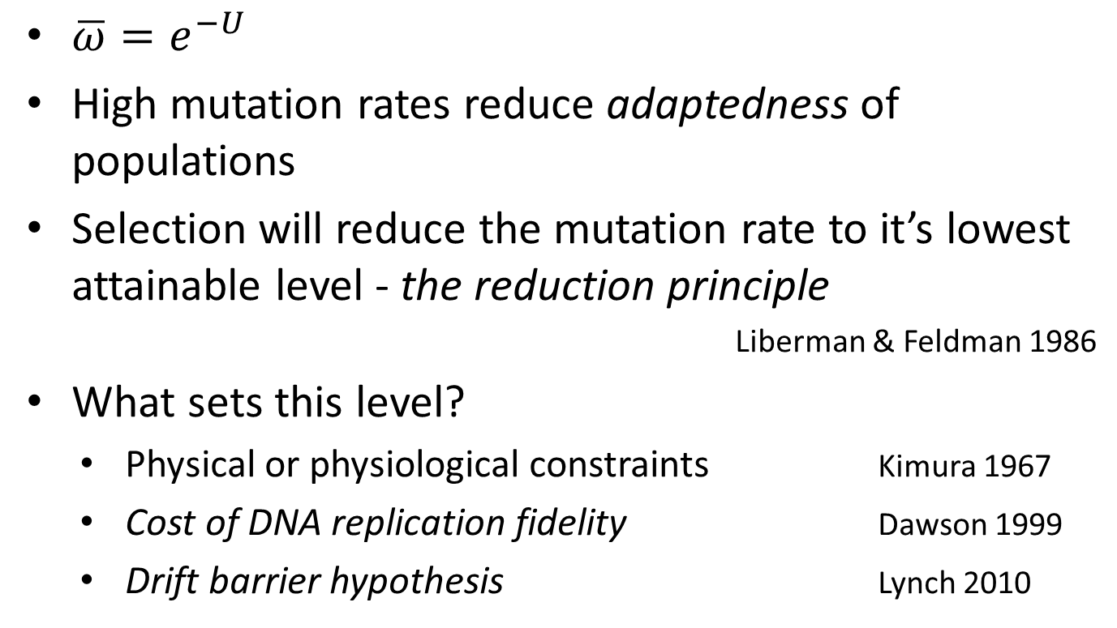
Mutation rate in static environments
$\overline{ω}=e^{−U}$
High mutation rates reduce adaptedness of populations
Selection will reduce the mutation rate to it’s lowest attainable level - the reduction principle
Liberman & Feldman 1986
What sets this level?
Physical or physiological constraints Kimura 1967
Cost of DNA replication fidelity Dawson 1999
Drift barrier hypothesis Lynch 2010

Slide 5

Evolution in a dynamic environment
In changing environments rapid adaptation can be favored by natural selection (adaptability)
The mutation rate must balance between adaptability and adaptedness Leigh 1973

Slide 6
Variability in mutation rates
Within species
Mutation rate in 69 natural populations of E. coli Matic et al. 1997

Slide 7
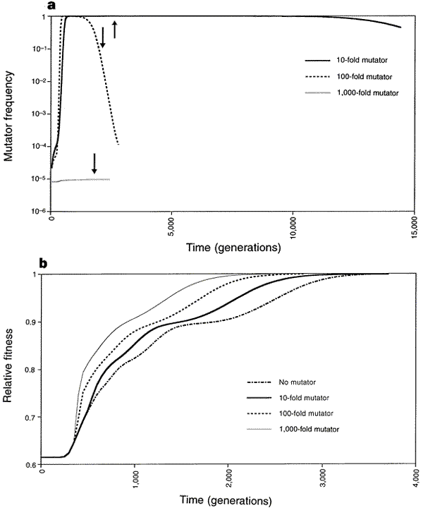
Adaptation with mutator alleles
x100
x10
x1
x1,000
Taddei, et al. Nature 1997

Slide 8
Rise and fall of the mutator allele
x10
x100
x1,000
Taddei, et al. Nature 1997
Notes:
An arrow symbolizes the time when population fitness has reached 0.99

Slide 9
Variability in mutation rates
Within individuals
DNA polymerase error rate Lynch 2011

Slide 10
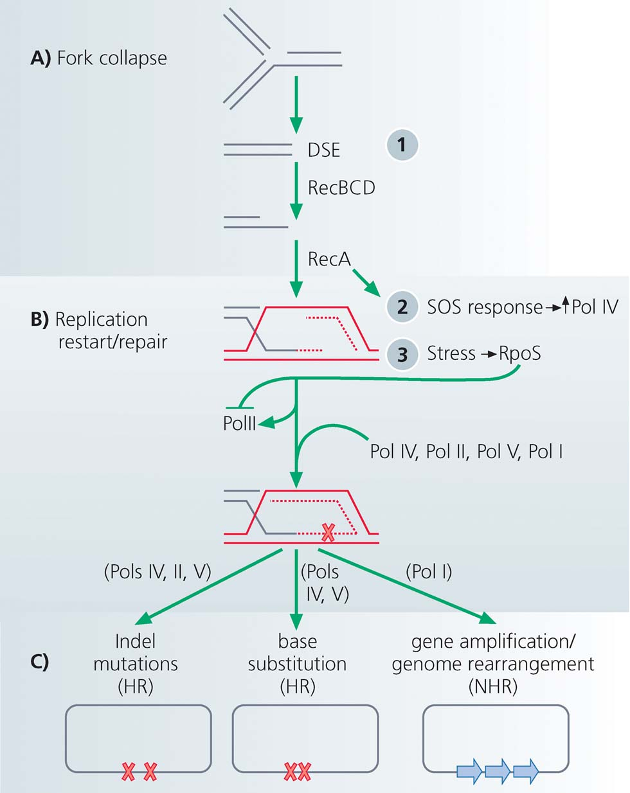
Stress-induced mutation
Rosenberg et al. 2012
In E. coli:
Error prone polymerase induced by stress responses:
SOS response
DNA damage
Starvation
Mismatch repair system
Other mechanisms:
Galhardo et al. 2007
Al Mamun, Science 2012

Slide 11
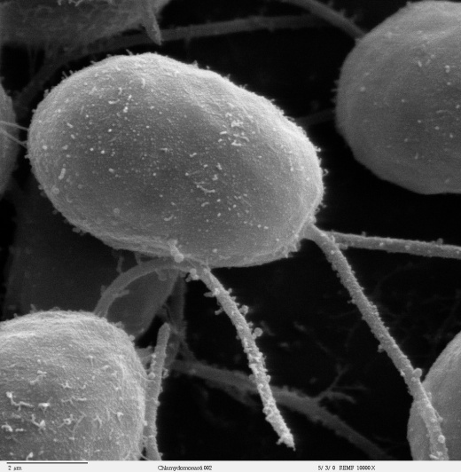
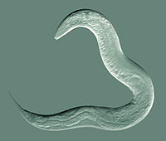
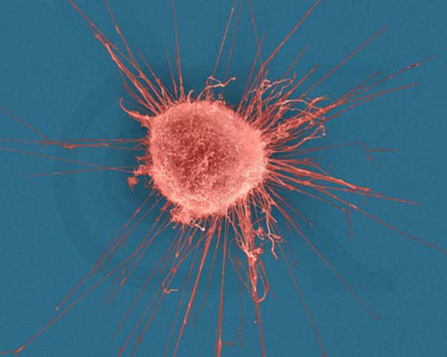

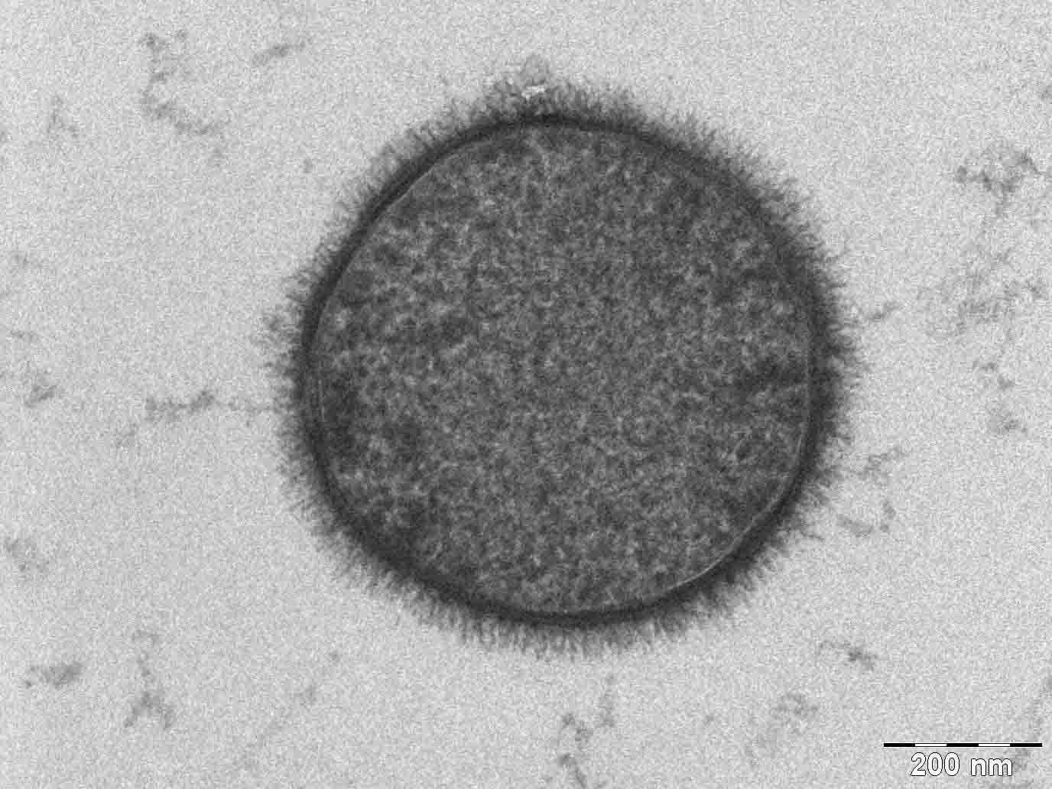
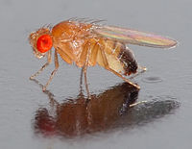
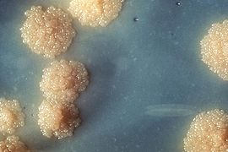
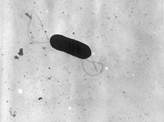
Evidence
Green algea
Nematodes
E. coli
Bacillus subtilis
Breast cancer cell
D. Melanogaster
M. tuberculosis
L. monocytogenes

Slide 12
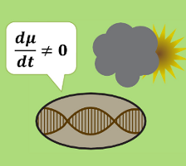
Evolution of stress-induced mutation
Null hypothesis
Mutagenesis is the by-product of stress
Alternative non-adaptive hypotheses
Cost of replication fidelity
Drift barrier hypothesis
Adaptive hypothesis
2nd order selection

Slide 13
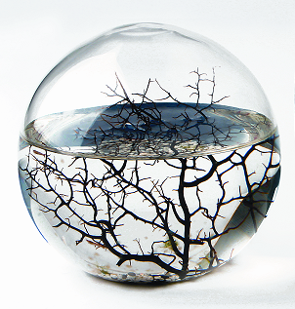
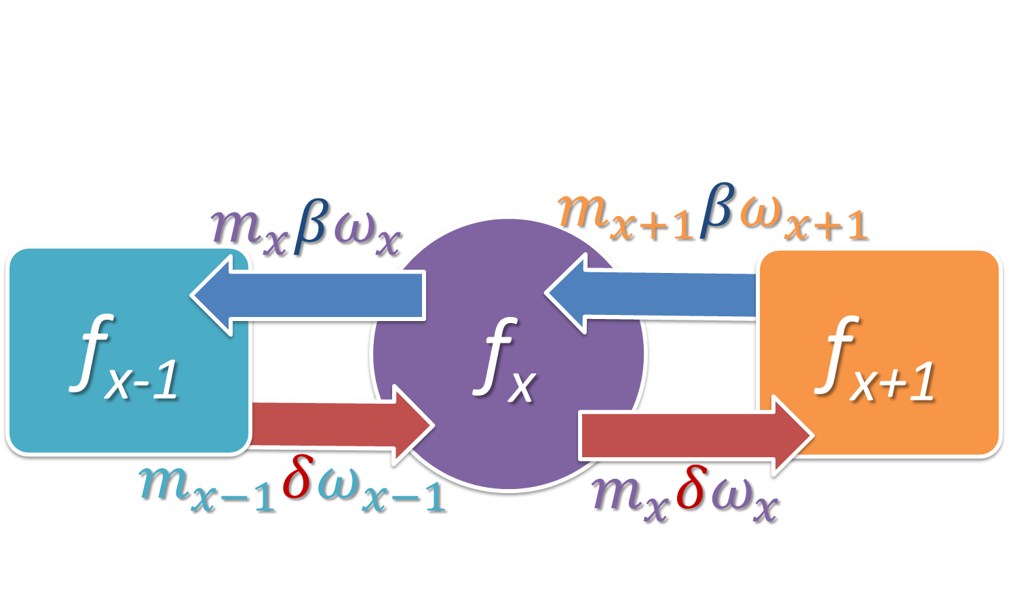
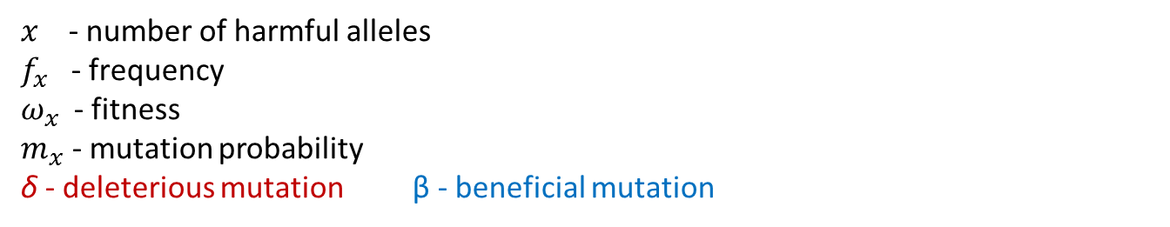
Static environment
Selection against generation of deleterious mutations
$x$ - number of harmful alleles
$f_{x}$ - frequency
$ω_{x}$ - fitness
$m_{x}$ - mutation probability
δ - deleterious mutation β - beneficial mutation
Ram & Hadany, Evolution 2012

Slide 14
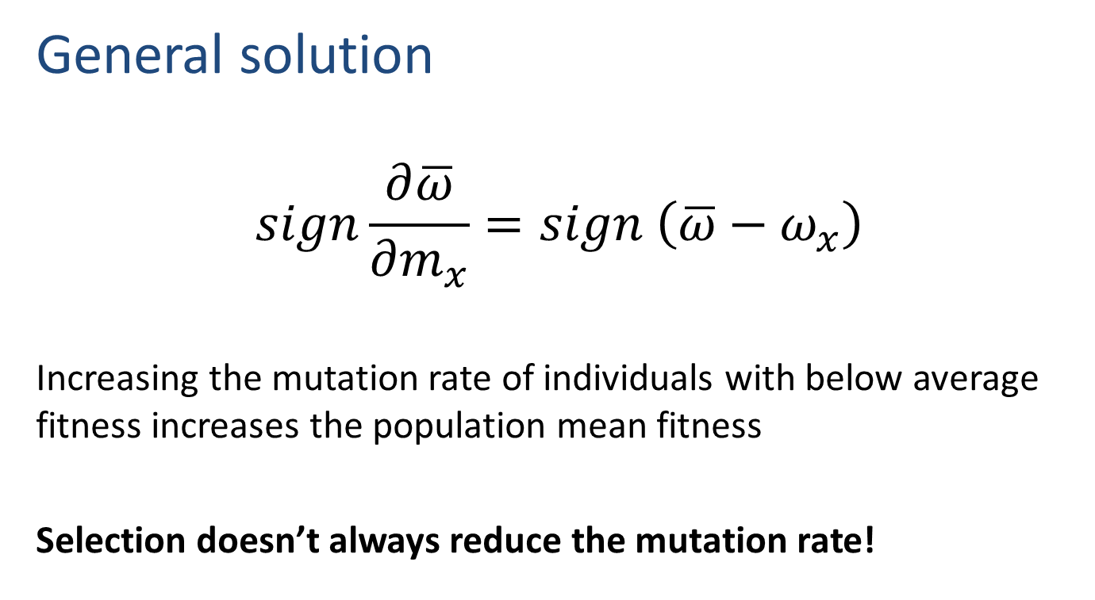
Static environment
General solution
$$sign\frac{∂\overline{ω}}{∂m_{x}}=sign \left(\overline{ω}−ω_{x}\right)$$
Increasing the mutation rate of individuals with below average fitness increases the population mean fitness
Selection doesn’t always reduce the mutation rate!
Ram & Hadany, Evolution 2012

Slide 15
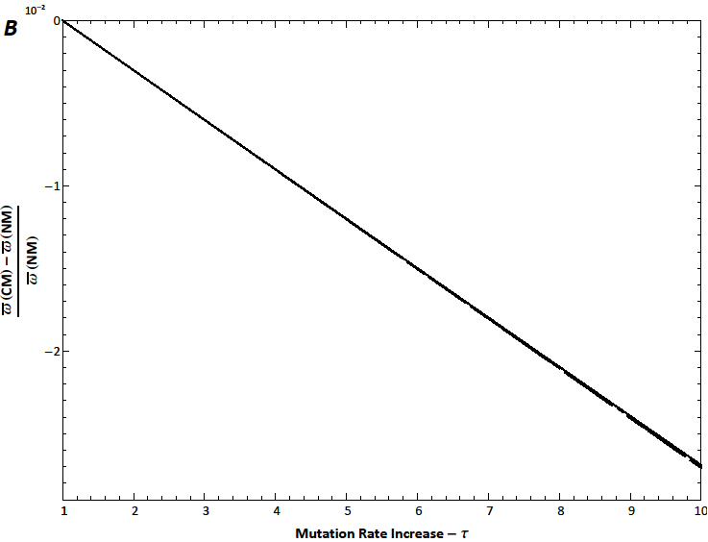
Static environments
Constitutive mutator (CM)
Ram & Hadany, Evolution 2012

Slide 16
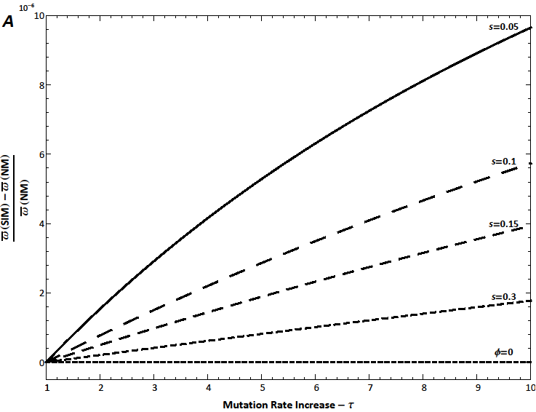
Static environments
Stress-induced mutator (SIM)
No beneficial mutations
Ram & Hadany, Evolution 2012

Slide 17

Rapidly changing environments
The Red Queen hypothesis (van Valen, 1973):
It takes all the running you can do, to keep in the same place.
- Lewis Carrol, Through the Looking Glass
What happens when the environment changes frequently?

Slide 18

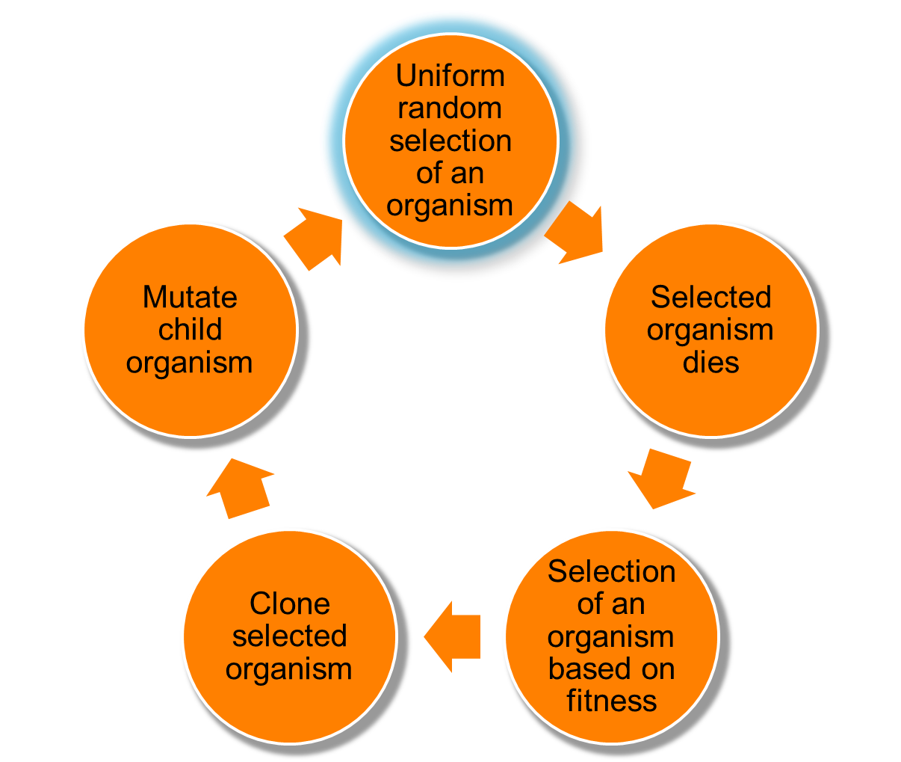
Changing environments
https://github.com/yoavram/proevolutionsimulation
Simulations
Moran process
Individual-based simulations
100,000 individuals
1,000 loci
Asexual, Haploid
Overlapping generations
No recombination
No segregation
No mutations at mutator locus
Environmental changes
Ram & Hadany, Evolution 2012

Slide 19
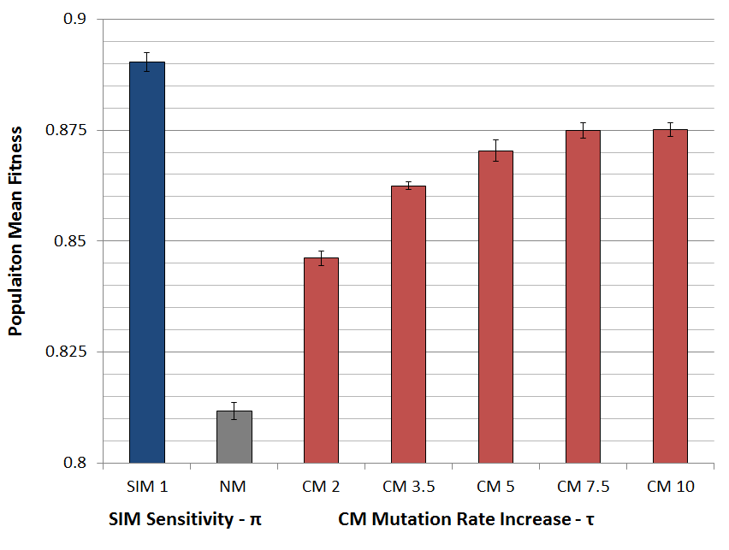
Populations with SIM are fitter
Ram & Hadany, Evolution 2012

Slide 20
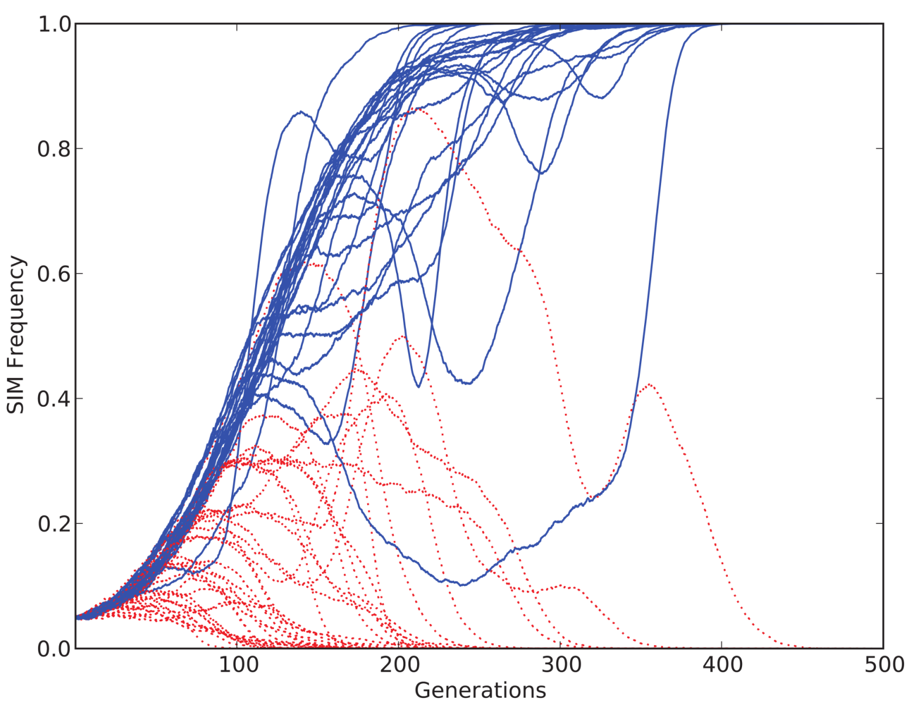
SIM wins competitions
Ram & Hadany, Evolution 2012

Slide 21
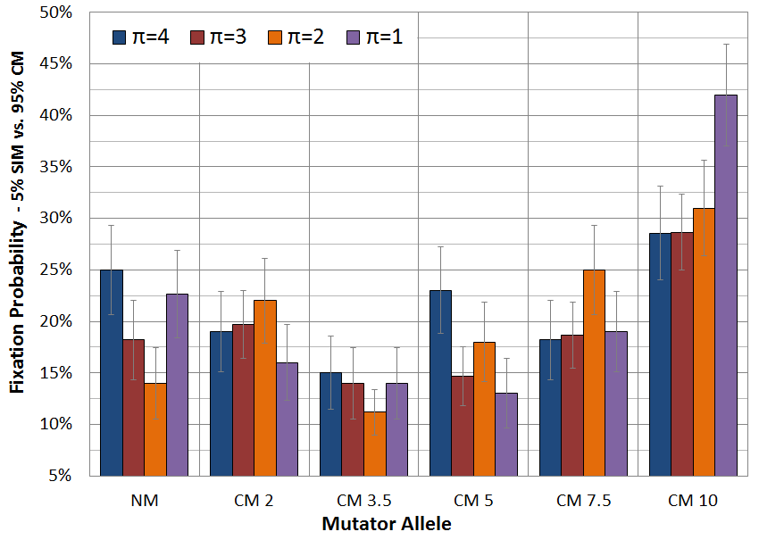
SIM wins competitions
Ram & Hadany, Evolution 2012

Slide 22
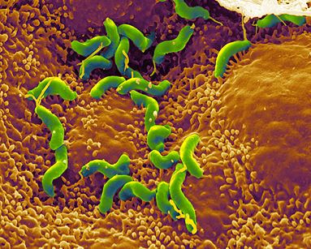
Conclusions
Stress-induced mutators evolve:
In finite & infinite populations
In constant & changing environments
2nd order selection can lead to the evolution of stress-induced mutagenesis in asexual populations
Selection for evolvability
H. pylori

Slide 23
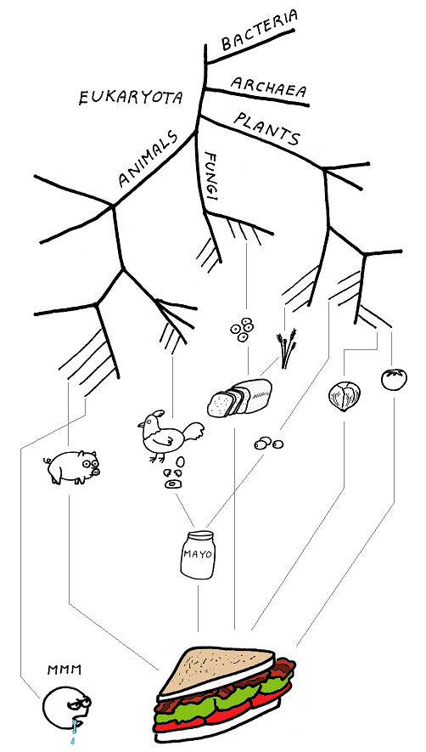
Consequences of Stress-Induced Mutagenesis
How does stress-induced mutagenesis
affect adaptation?
abstrusegoose.com/339

Slide 24
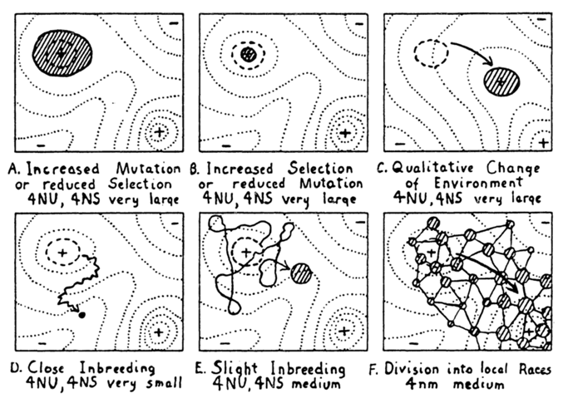
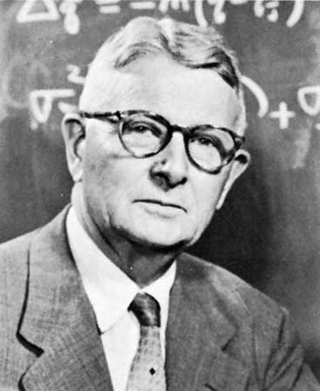
Adaptive peak shifts
Sewall Wright, 1931:
If a new adaptation requires several, separately deleterious mutations, how can it evolve?
Wright, Am. Nat. 1988

Slide 25
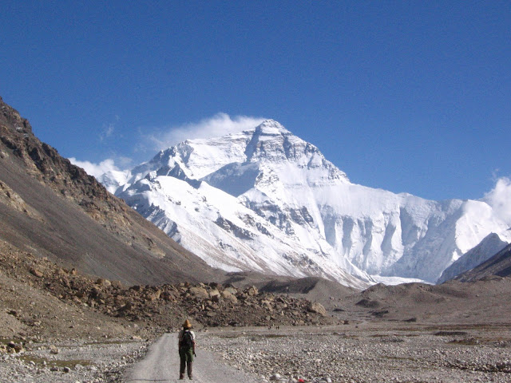
Simple landscape

Slide 26
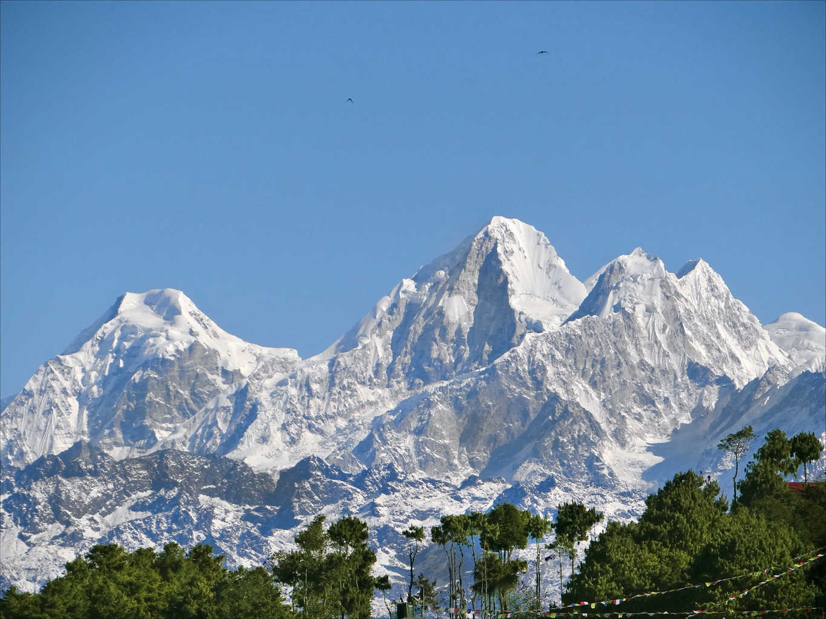
Rugged landscape

Slide 27
Adaptive peak shift

Slide 28
SIM & rugged landscapes
Increasing the mutation rate in individuals below both peaks
High mutation rate
Low mutation rate

Slide 29
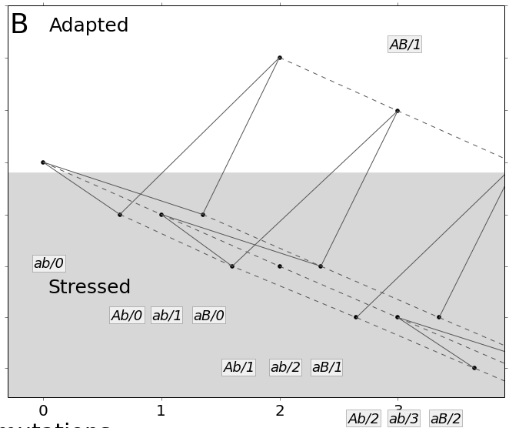
Model
https://github.com/yoavram/ruggedsim
Ram & Hadany, PRSB 2014

Slide 30
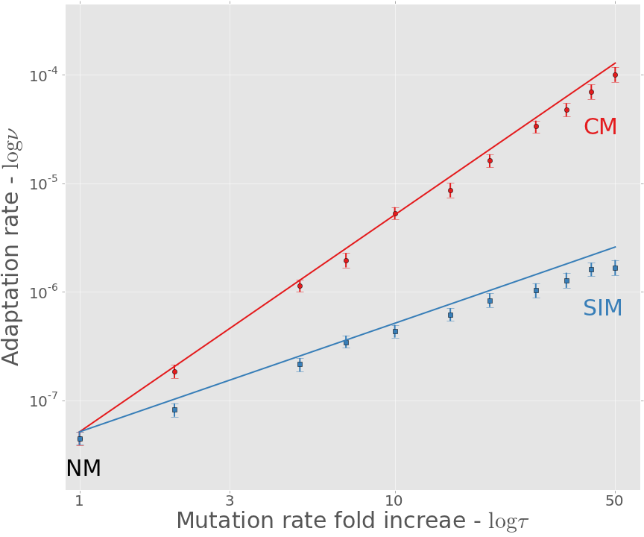

Adaptation rate
https://github.com/yoavram/ruggedsim
$$ν_{CM}≈τ^{2}∙ν_{NM}$$
$$ν_{SIM}≈τ∙ν_{NM}$$
Approximation
Simulation
Ram & Hadany, PRSB 2014

Slide 31
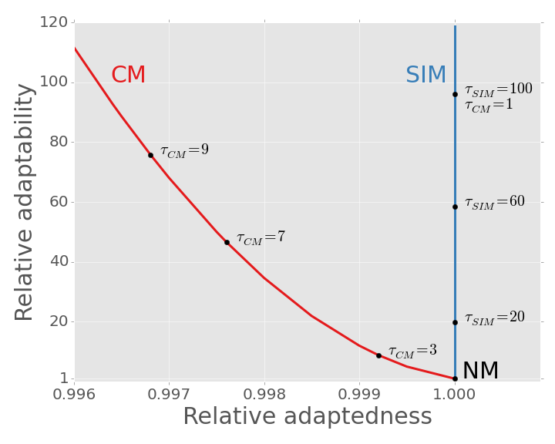
SIM Breaks the adaptability-adaptedness trade-off
Ram & Hadany, PRSB 2014

Slide 32
Conclusions
Effects of stress-induced mutagenesis:
SIM increases the adaptation rate without reducing the population mean fitness
Breaks the trade-off between adaptability and adaptedness
Ram & Hadany, PRSB 2014

Slide 33
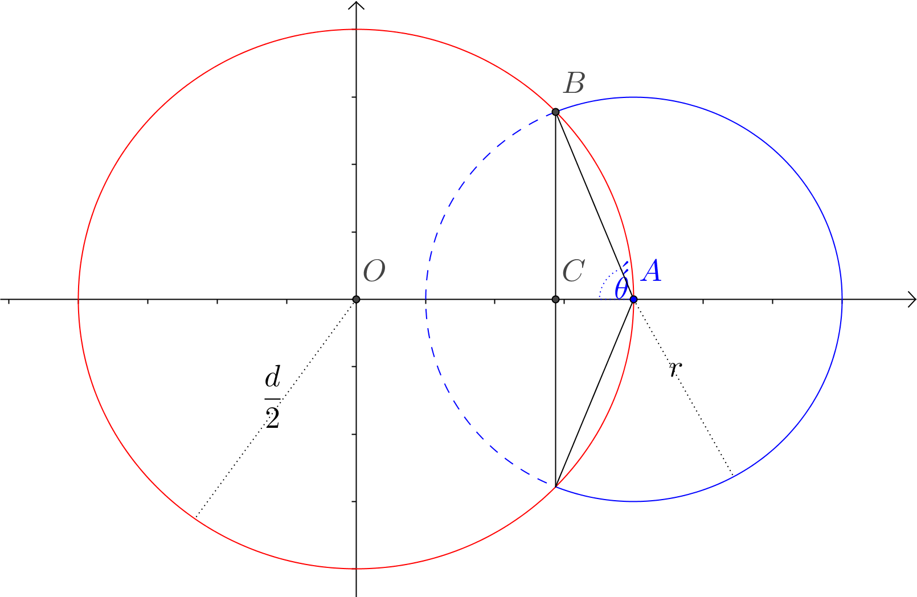
The probability of improvement in Fisher's geometric model

Slide 34
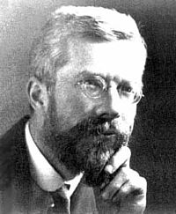
Introduction
Fisher introduced his “geometric model” in page 32 of the book The Genetical Theory of Natural Selection
Mutation pleiotropy
Support for adaptation by small mutations
Criticisms:
Wright: adaptive peak shifts
Kimura: fixation probability
Sir Ronald A. Fisher
1890-1962
England & Australia

Slide 35

Fisher’s geometric model in 2D
phenotypes with
same fitness
Optimal
phenotype
Current
phenotype
mutants
with
higher
fitness
all possible mutants

Slide 36
Fisher’s geometric model in 2D
What is the probability that a random point on the blue circle will be inside the red circle?

Slide 37
Fisher’s geometric model in 2D
The fraction of the blue circle that is inside the red circle: the dashed blue arc

Slide 38
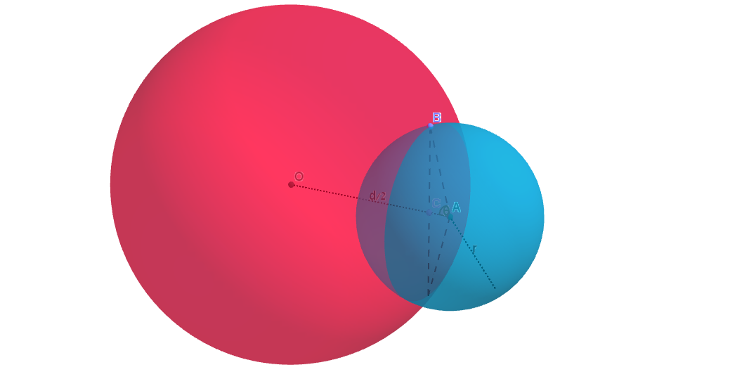
Fisher’s geometric model in 3D
The fraction of the blue sphere that is inside the red sphere: the shaded blue spherical cap
B
O
d/2
C
A
θ
r

Slide 39
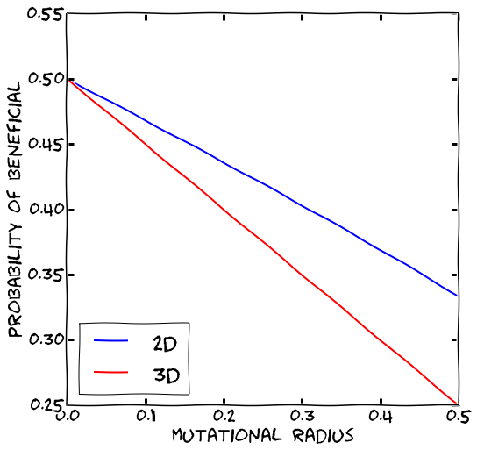

Comparison: 2D vs. 3D
$$p_{2D}=\frac{\cos^{−1}\left(\frac{r}{d}\right)}{π}$$
$$p_{3D}=\frac{1}{2}\left(1−\frac{r^{2}}{d}\right)$$

Slide 40
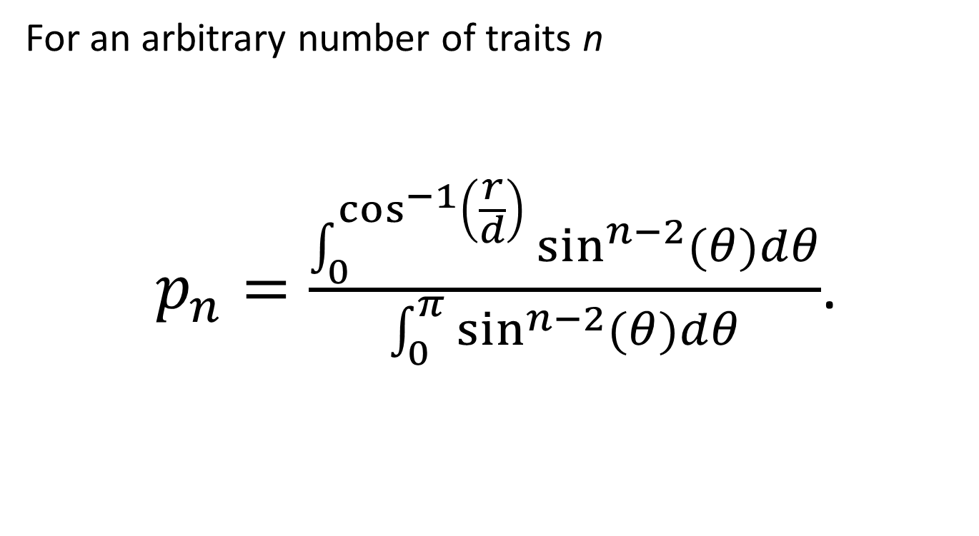
General result
For an arbitrary number of traits n
$p_{n}=\frac{\int_{0}^{\cos^{−1}\left(\frac{r}{d}\right)}{\sin^{n−2}{(θ)}dθ}}{\int_{0}^{π}{\sin^{n−2}{(θ)}dθ}}$.
Rice 1990, Hartl & Taubes 1996, Waxman & Welch 2005

Slide 41
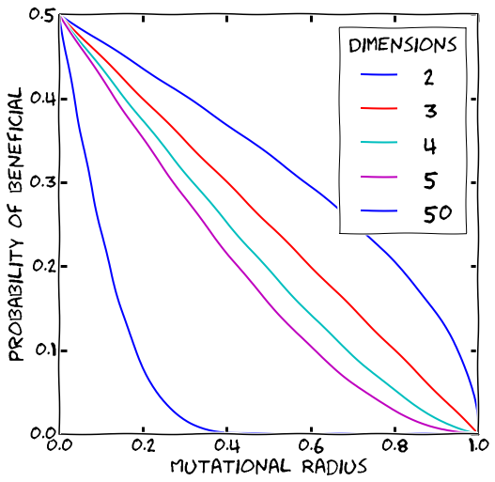
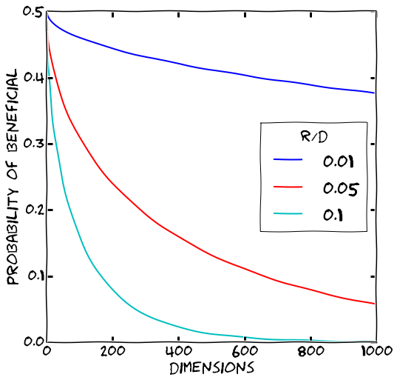
Multiple traits

Slide 42
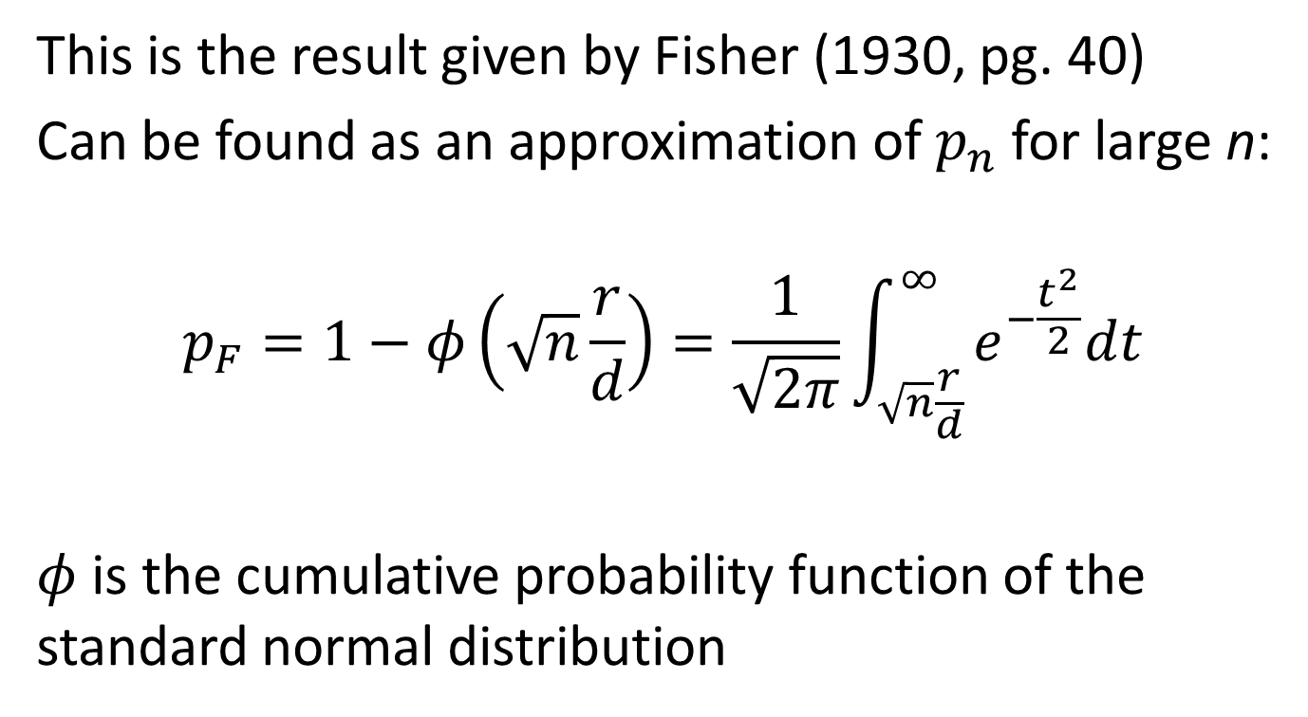
Asymptotic result for many traits
This is the result given by Fisher (1930, pg. 40)
Can be found as an approximation of $p_{n}$ for large n:
$$p_{F}=1−φ\left(\sqrt{n}\frac{r}{d}\right)=\frac{1}{\sqrt{2π}}\int_{\sqrt{n}\frac{r}{d}}^{∞}{e^{−\frac{t^{2}}{2}}dt}$$
$φ$ is the cumulative probability function of the standard normal distribution

Slide 43
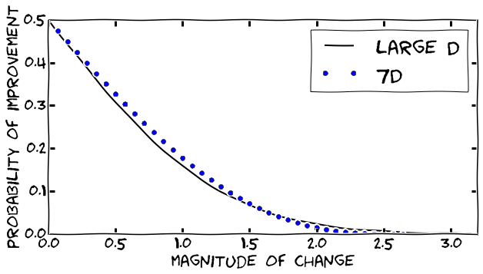
Comparison of asymptotic result

Slide 44
General result
Previous authors used arguments from analytical geometry
I have found an alternative probabilistic approach
First step – draw random points on a sphere, these will be the mutations

Slide 45
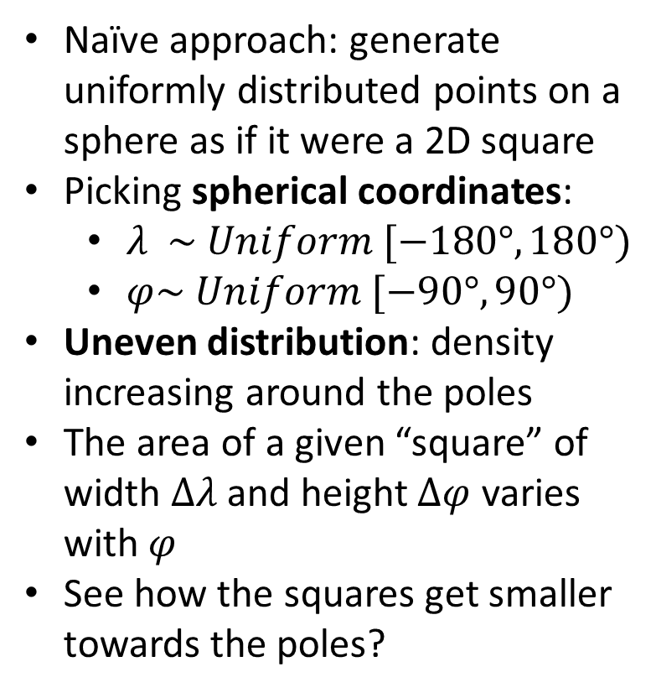
Random points on a sphere
Naïve approach: generate uniformly distributed points on a sphere as if it were a 2D square
Picking spherical coordinates:
$λ \sim Uniform [−180°, 180°)$
$φ\sim Uniform [−90°, 90°)$
Uneven distribution: density increasing around the poles
The area of a given “square” of width $Δλ$ and height $Δφ$ varies with $φ$
See how the squares get smaller towards the poles?
http://www.jasondavies.com/maps/random-points/

Slide 46

Random points on a sphere
Any area on the sphere should contain approximately the same density of points
$λ \sim Uniform [−180°, 180°)$
$x \sim Uniform [0, 1)$
$φ =\cos^{−1}\left(2x − 1\right)$
Some points seem too close together, and some seem too far apart. This is OK!

Slide 47
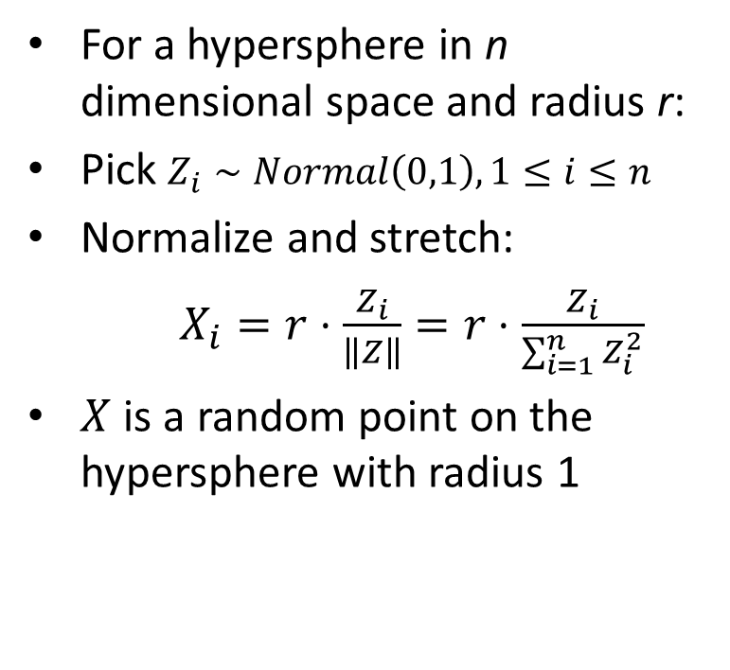
Random points on a hypersphere
For a hypersphere in n dimensional space and radius r:
Pick $Z_{i}∼Normal\left(0,1\right), 1≤i≤n$
Normalize and stretch:
$X_{i}=r⋅\frac{Z_{i}}{\left\|Z\right\|}=r⋅\frac{Z_{i}}{\sum_{i=1}^{n}{Z_{i}^{2}}}$
$X$ is a random point on the hypersphere with radius 1
http://mathworld.wolfram.com/SpherePointPicking.html
Muller, 1959

Slide 48
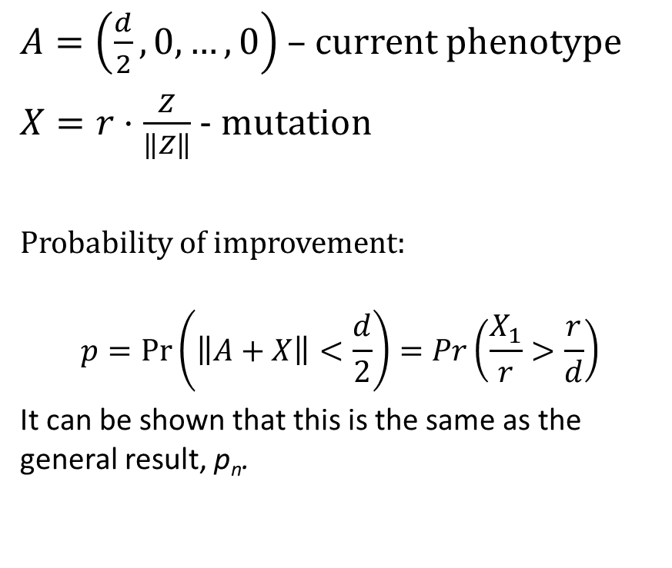
Our probabilistic approach
$A=\left(\frac{d}{2},0,…,0\right)$ – current phenotype
$X=r⋅\frac{Z}{\left\|Z\right\|}$ - mutation
Probability of improvement:
$$p=\operatorname{Pr}\left(\left\|A+X\right\|<\frac{d}{2}\right)=Pr\left(\frac{X_{1}}{r}>\frac{r}{d}\right)$$
It can be shown that this is the same as the general result, p_{n}.
Ram & Hadany, TPB 2015

Slide 49
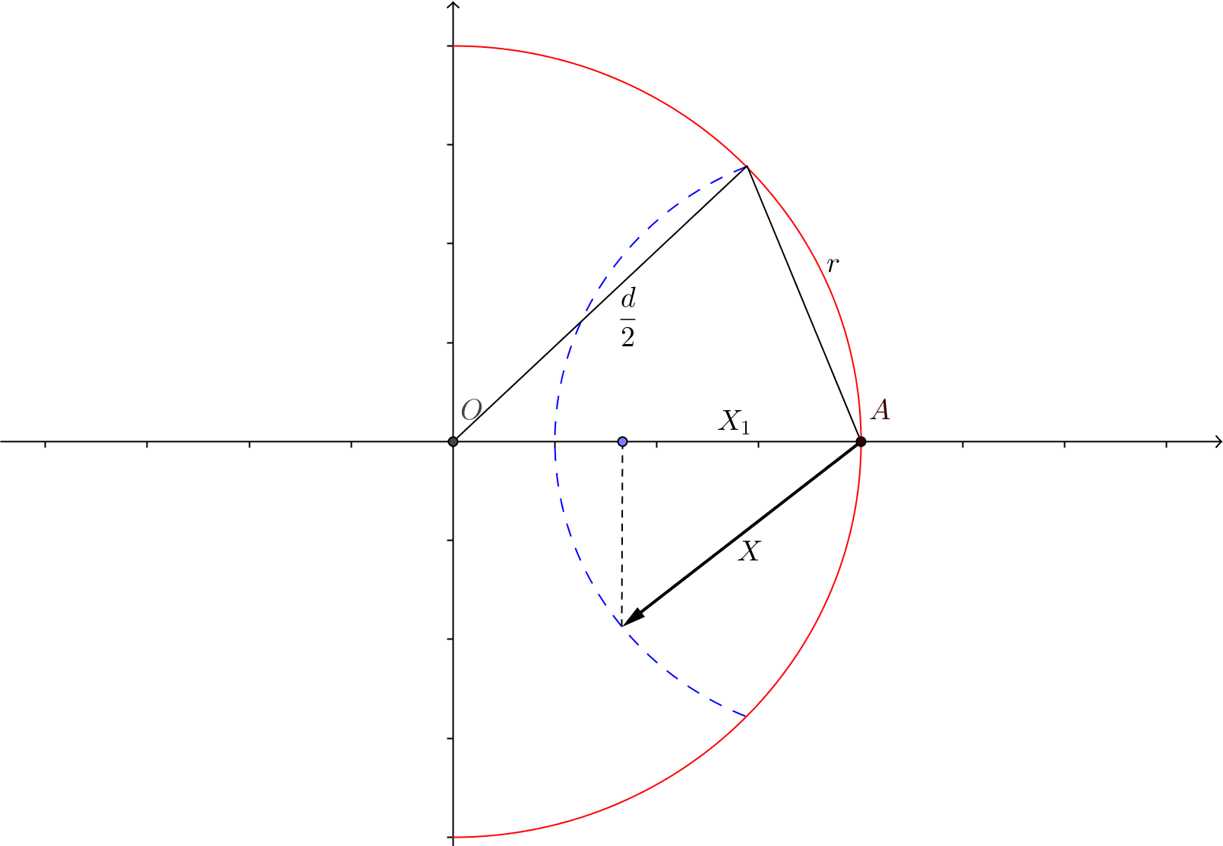
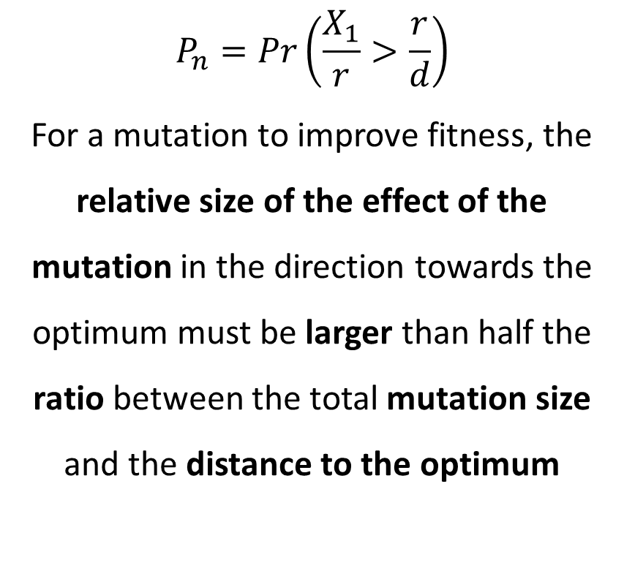
New intuition
$$P_{n}=Pr\left(\frac{X_{1}}{r}>\frac{r}{d}\right)$$
For a mutation to improve fitness, the relative size of the effect of the mutation in the direction towards the optimum must be larger than half the ratio between the total mutation size and the distance to the optimum
Ram & Hadany, TPB 2015

Slide 50
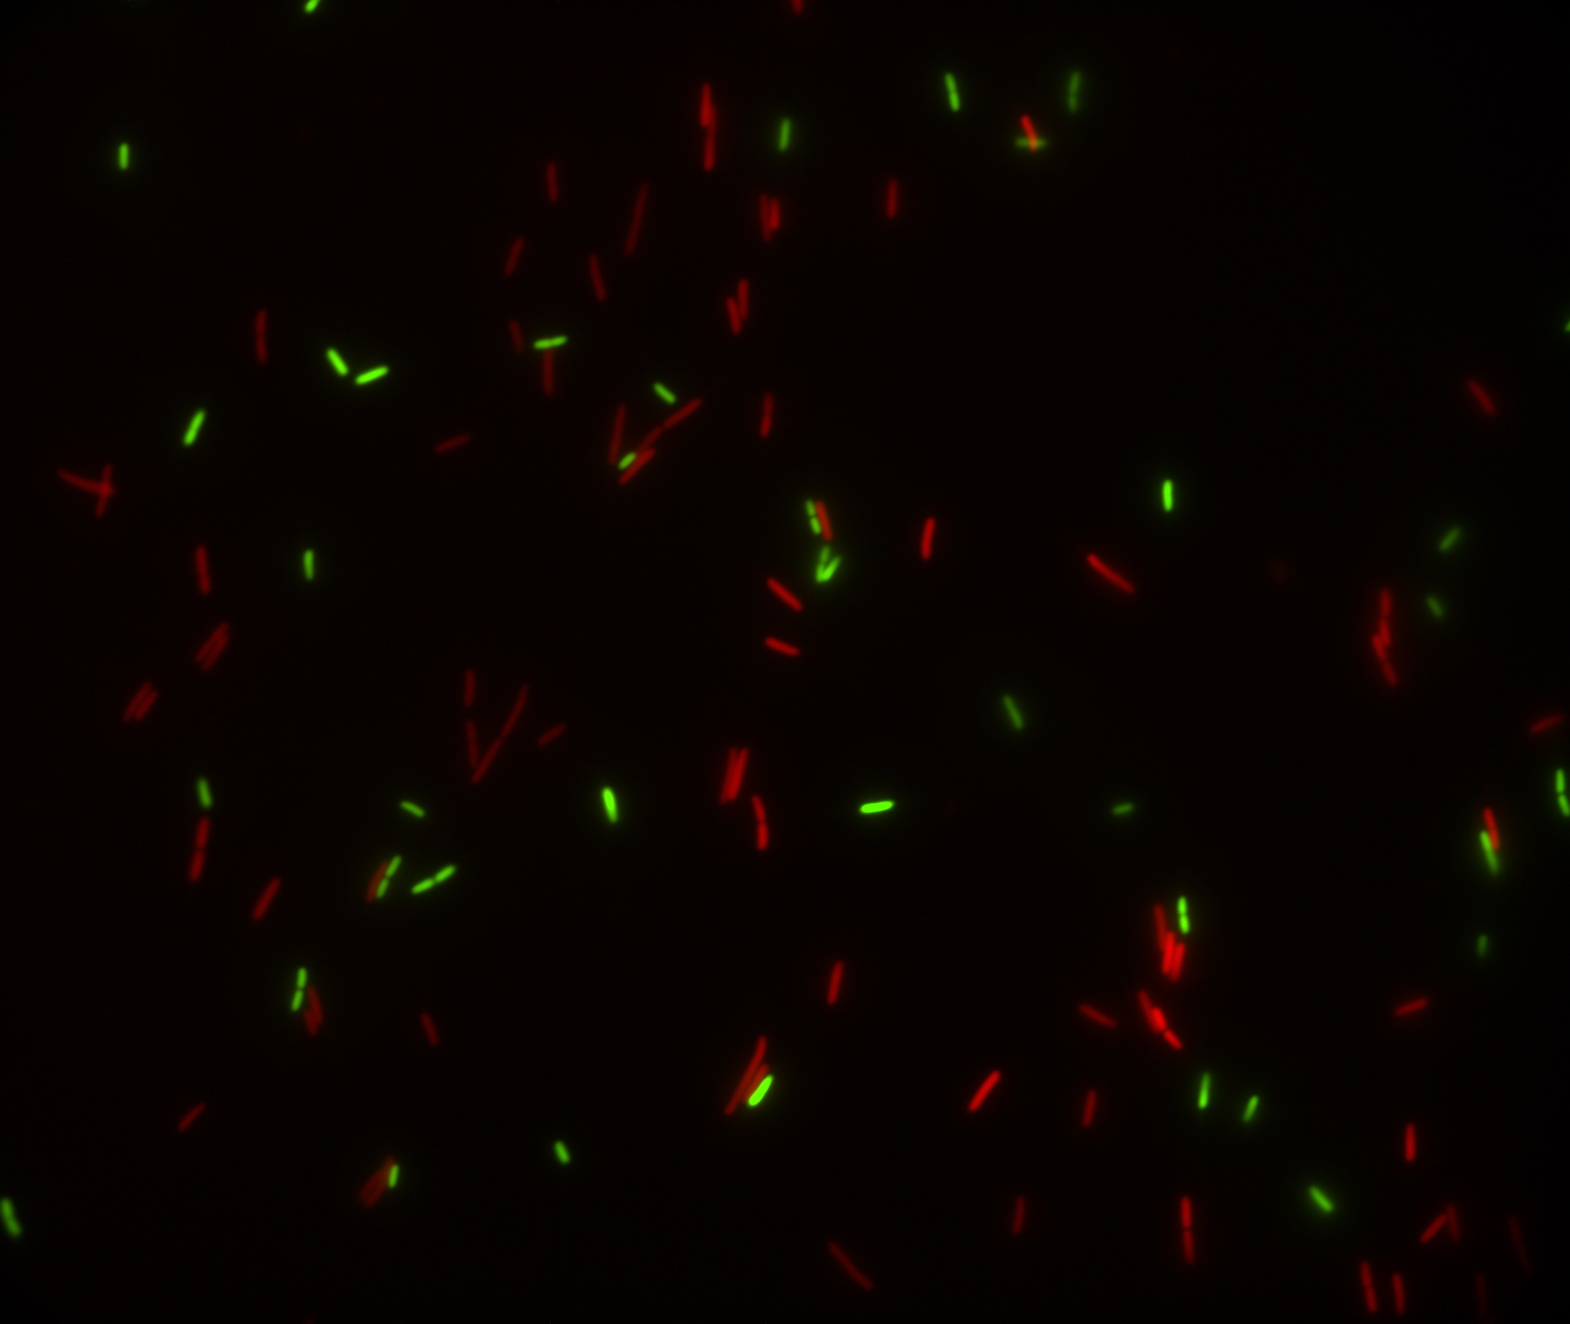
Predicting microbial growth in a mixed culture

Slide 51


Competition experiments
Strains must have a genotypic or phenotypic marker
Problem: Laborious and Costly, more so for non-model organisms
Our Solution: Computational framework that predicts growth in mixed culture
Fit growth models to growth curves
Predict competition results
Infer fitness
Ara⁻
Ara⁺

Slide 52

Growth curve data
Data from two experiments with E. coli strains: (DH5α vs. TG1) fitted with the Baranyi-Roberts model Baranyi & Roberts, 1994
with lag phase
without lag phase

Slide 53


Mixed culture prediction

Slide 54
Summary
Fit growth models to growth curves
Use growth models to predict growth in mixed culture
Use prediction to infer relative fitness
Focus on resource competition
Preprint:
Ram et al. (2015) Predicting competition results from growth curves. bioRxiv, doi:10.1101/022640
Software website: curveball.yoavram.com

Slide 55
Future directions
Complex growth curves:
Bi-phasic growth:
Deep stationary phase
Cell death
Null model for detection of frequency-dependent interactions
Cooperation
Interference
Compete hypothetical strains
Predict adaptive evolution
Interpret fitness differences

Slide 56








Acknowledgments
Lilach Hadany
Uri Obolski
Eynat Dellus-Gur
Ariel Guiejman
Eyal Zinger
Itzhak Khait
Ohad Lewin-Epstein
Judith Berman
Maayan Bibi
Ella Shtifman Segal
Noa Wertheimer
Alex Rosenberg,
Adi Zisman
Feng Yang
Yitzhak Pilpel
Orna Dahan
Dorit Hizi
Itamar Françoise
Idan Frumkin
Eran Even-Tov
Ishay Ben-Zion
Avihu Yona
David Gilat
Lior Zelcbuch
Rafi Yaari
Committees
Tal Pupko
Avigdor Eldar
Arnon Lotem
Itay Mayrose
Israeli Ministry
of Science & Technology
Contact
The Anat Karuskopf Fund
yoav@yoavram.com
@yoavram
github.com/yoavram
www.yoavram.com
a

